Slide 1
Amazon RDS for PostgreSQL – Scaling and Optimization
Fully managed relational database service

Slide 2
Agenda
RDS Scaling & Flexibility
RDS Storage scaling
RDS Instance Vertical scaling
RDS Horizontal scaling - adding read replica(s)

Slide 3

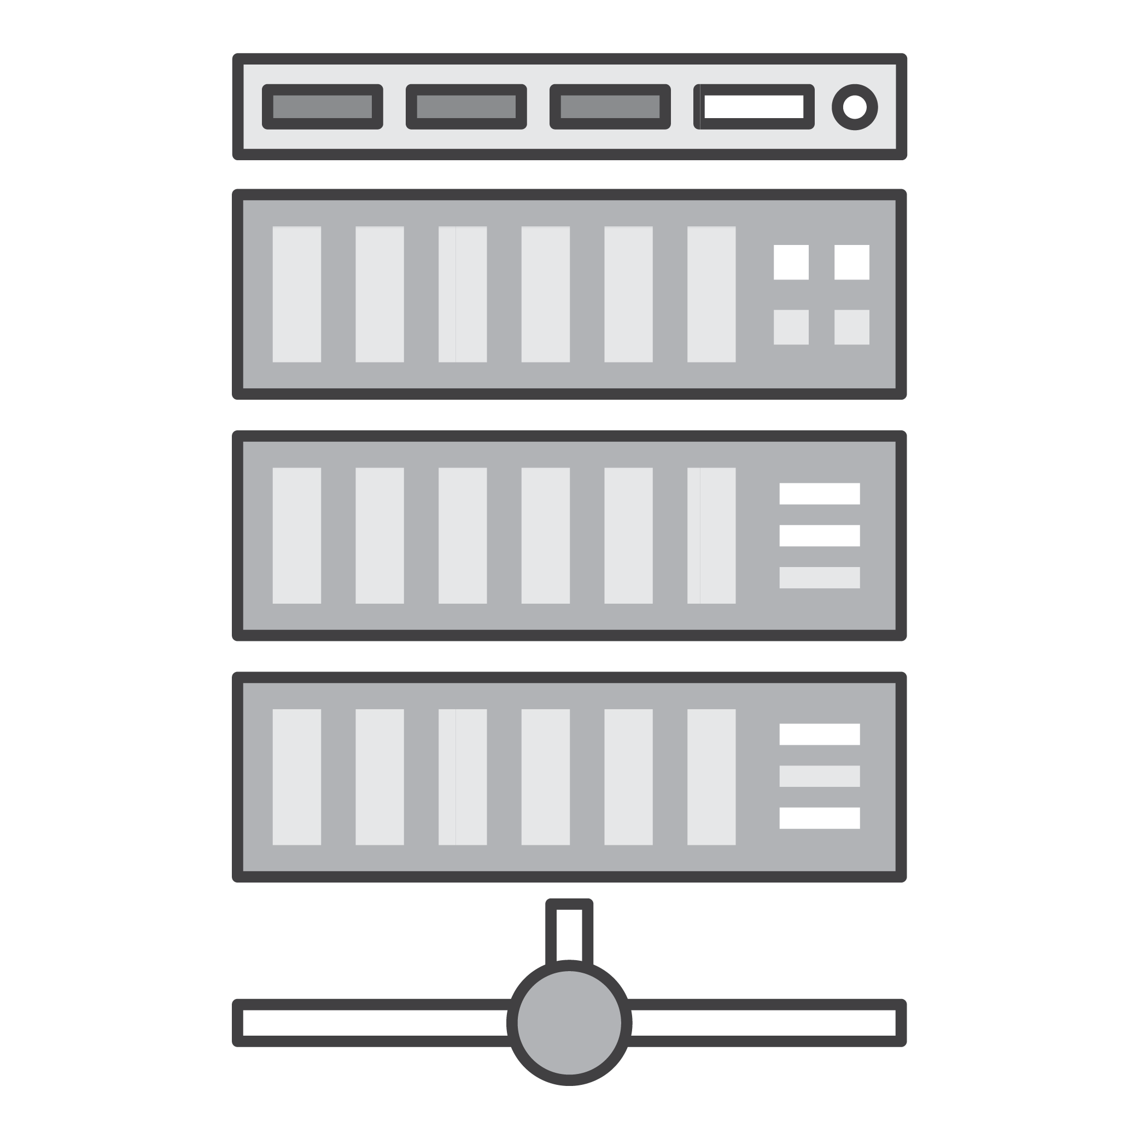
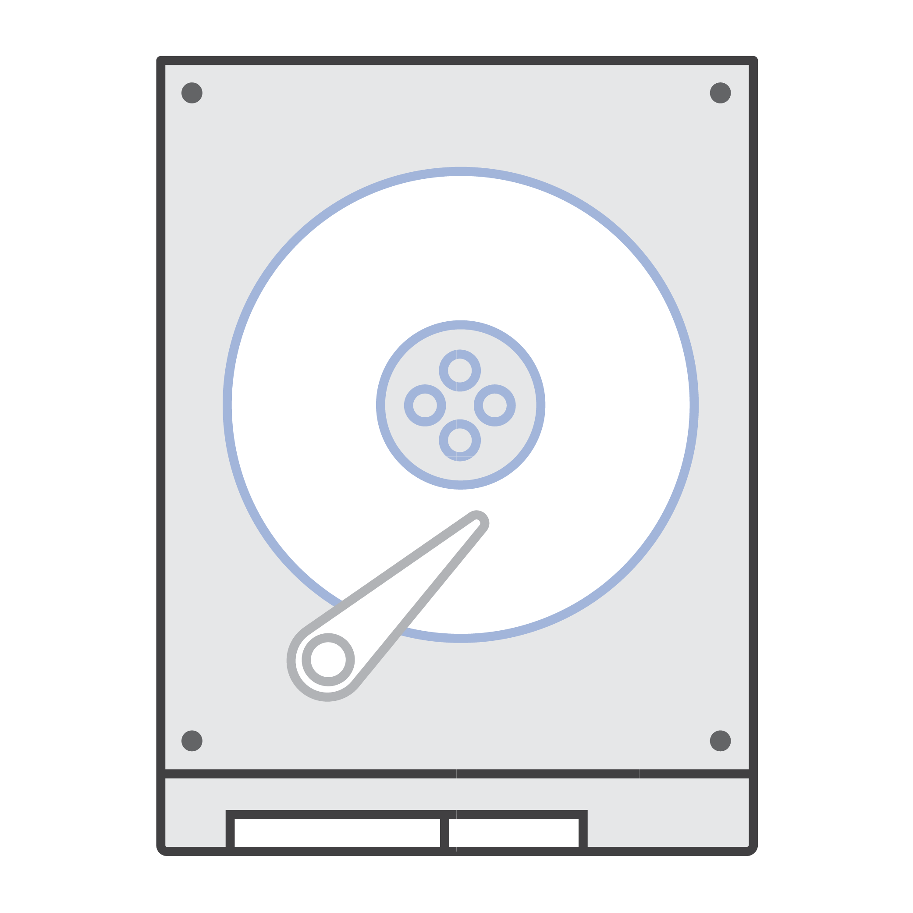

RDS Performance Factors
RDS DB Instance Class
Network attached storage
Compute Capabilities
vCPUs
Memory Capabilities
GB of RAM
Network Performance
MB/s (Throughput)
Storage Performance
I/O Throughput
RDS Storage Type

Slide 4
Scale Compute and Storage with Ease & independence
Scale Compute to
Handle Increased Load
Up to 96 vCPUs and
Up to 768 GiB of RAM
Scale Storage for
Larger Data Sets
Scalable EBS storage up to 64 TiB
Scale Down to
Control Costs
As little as 1 vCPU and
1 GiB of RAM

Slide 5
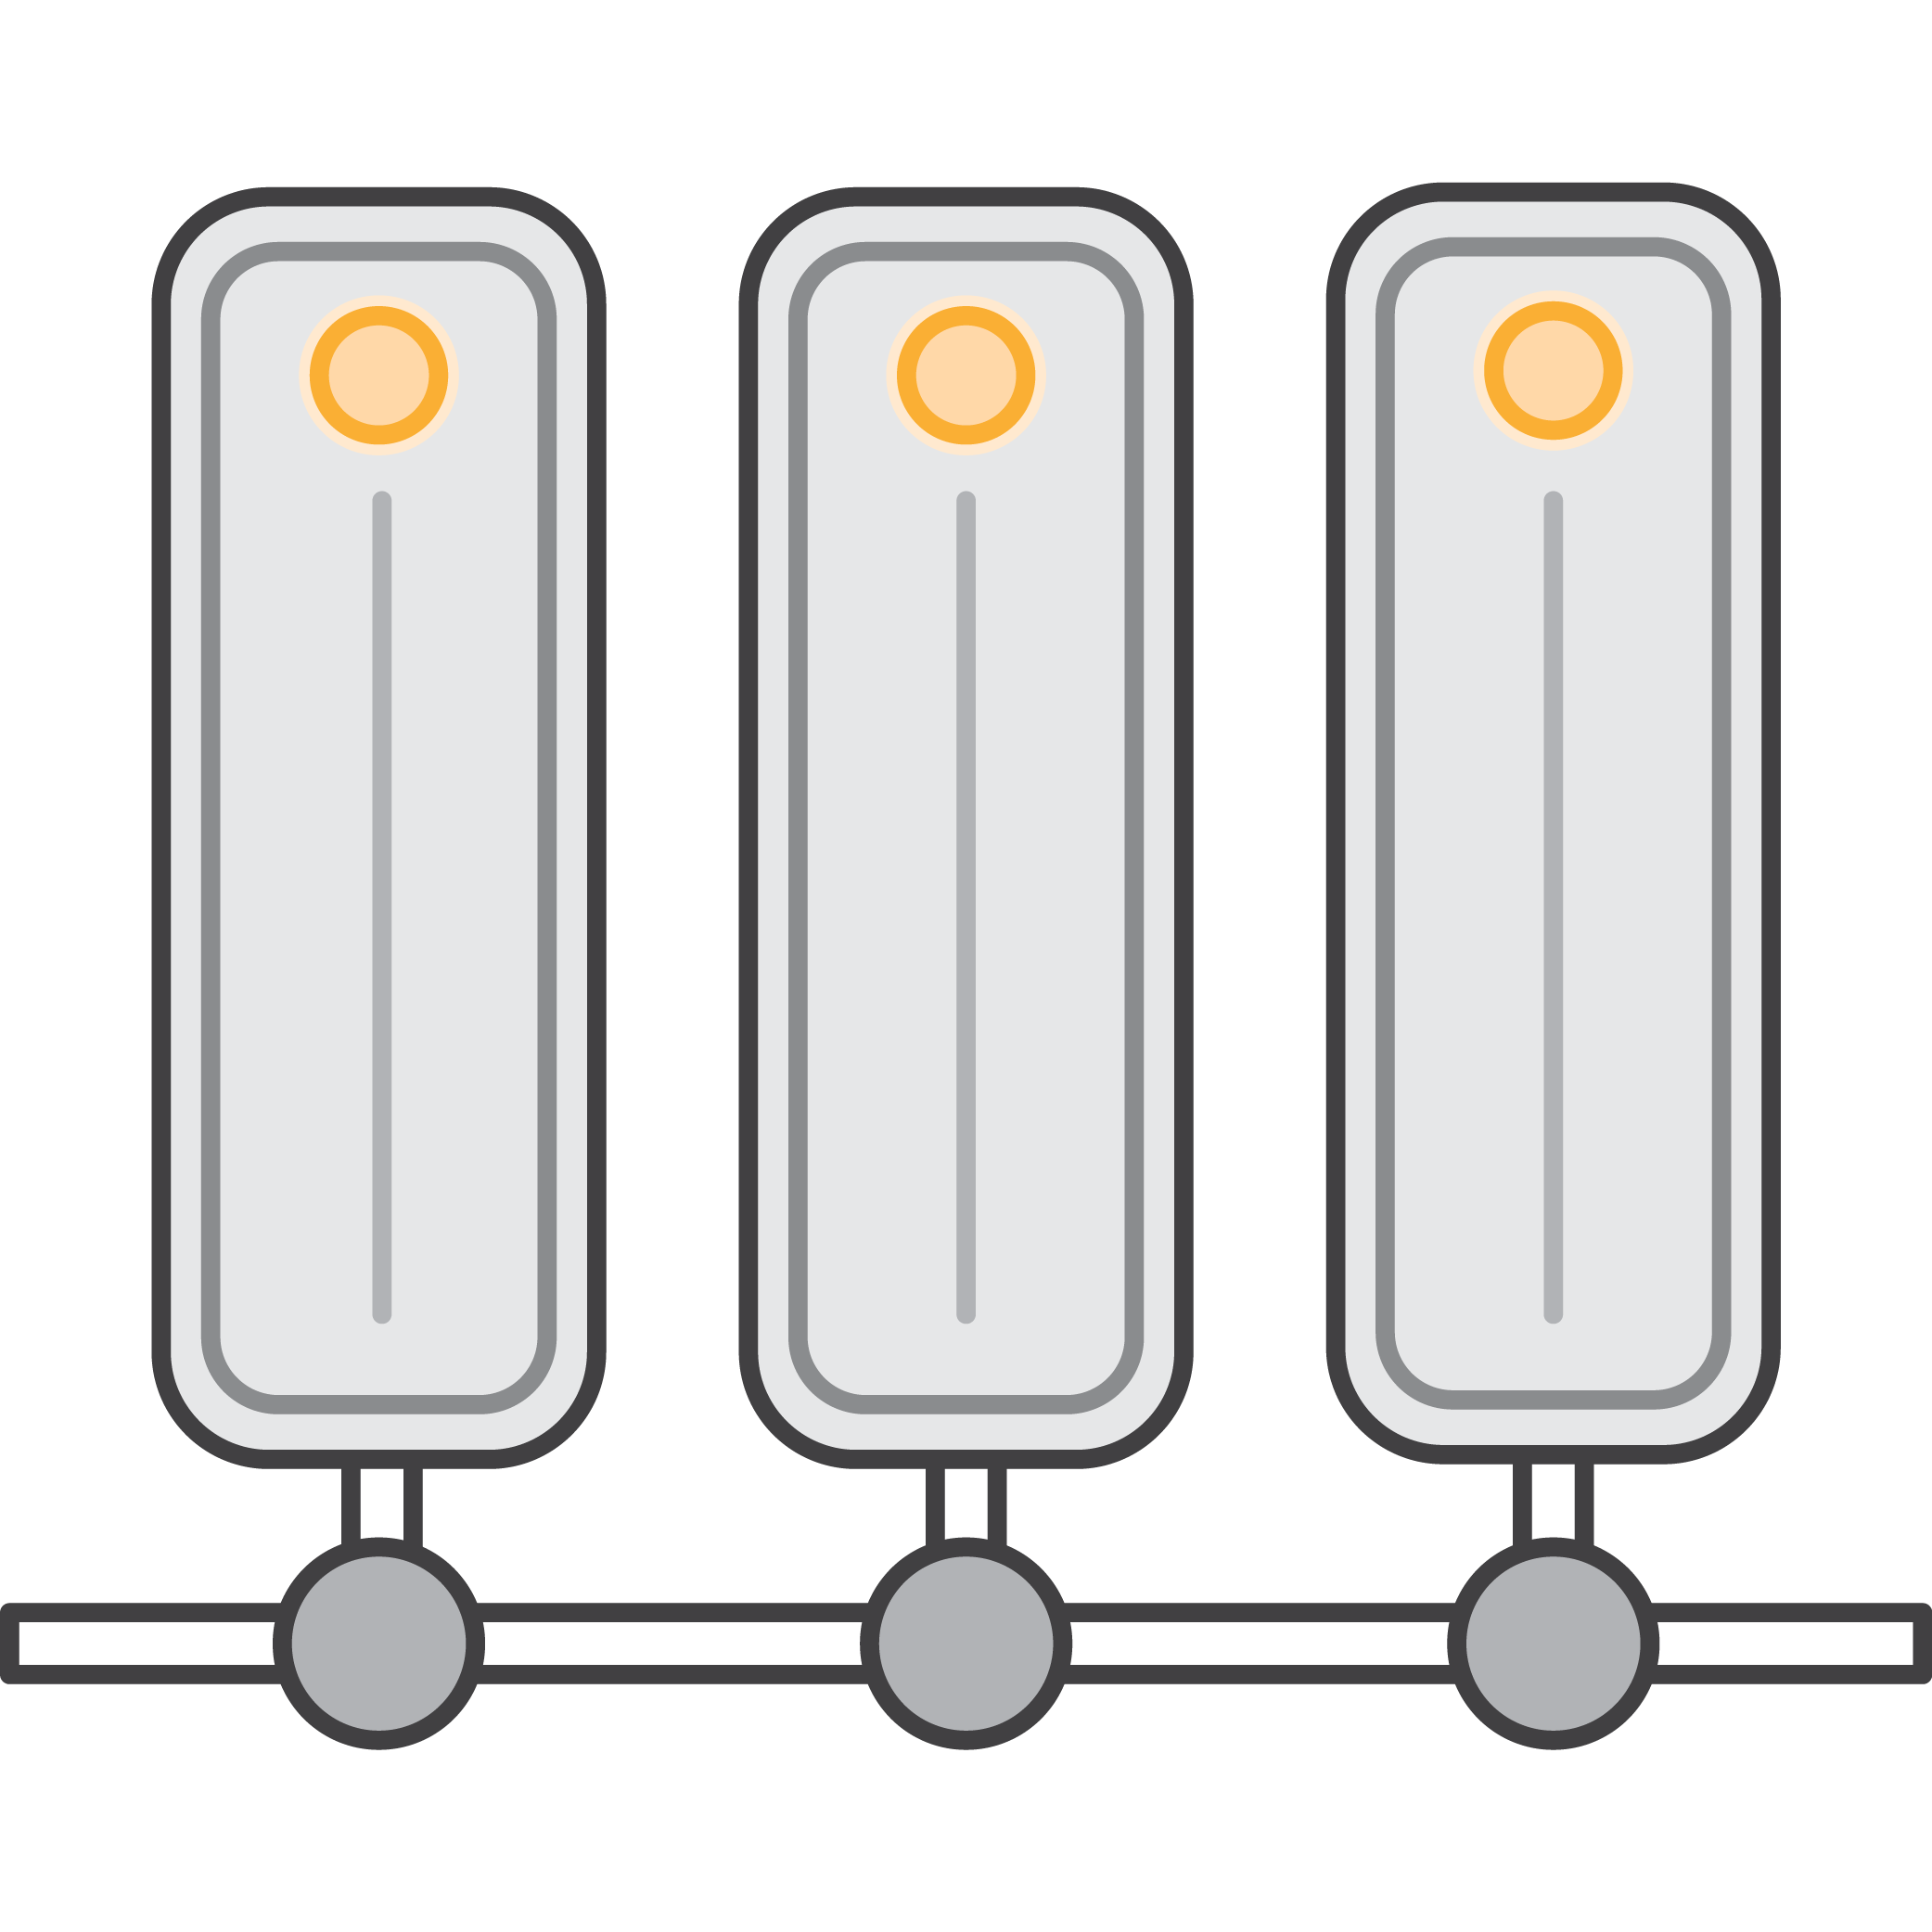
Amazon Elastic Block Storage
Network-attached block storage
Native redundancy and write cache
Consistent and low-latency performance
Optimized for random I/O
Many instance types support EBS optimization
Dedicated channel for network storage I/O
Eliminating contention with regular I/O

Slide 6
Choosing the Right Storage
 |  | Performance
Type | Size | IOPs | Burst | Pricing
GP2 (General Purpose SSD) | 20 GiB - 64 TiB | 3 IOPs/GiB, up to 16,000 IOPs | Yes, up to 3000 IOPS per volume, subject to credits (< 1 TiB in size) | Allocated storage
IO1 (Provisioned IOPS SSD) | Up to 64 TiB | 1,000 - 80,000 IOPs* | No, fixed allocation | Allocated storage; Provisioned IOPS
* Nitro-based instance types, ½ for other instance types.
DB instance can be modified to change storage
Can modify size (increase size), type, and PIOPs
Size modifications available within minutes
No downtime, performance may degrade during change
Notes:
The Nitro System is a collection of AWS-built hardware and software components that enable high performance, high availability, and high security. In addition, the Nitro System provides bare metal capabilities that eliminate virtualization overhead and support workloads that require full access to host hardware. For more information, see AWS Nitro System.
Nitro components
The following components are part of the Nitro System:
Nitro card
Local NVMe storage volumes
Networking hardware support
Management
Monitoring
Security
Nitro security chip, integrated into the motherboard
Nitro hypervisor - A lightweight hypervisor that manages memory and CPU allocation and delivers performance that is indistinguishable from bare metal for most workloads.
https://aws.amazon.com/ec2/nitro/
https://www.metricly.com/aws-nitro/

Slide 7
Amazon RDS storage scaling
At least 6 hours between API calls
ModifyDBInstance
ModifyDBInstance
2 TiB
Up to 64 TiB
1 TiB
ModifyDBInstance
ModifyDBInstance
io1 10,000 IOPS
io1 20,000 IOPS
Up to 80,000 IOPS
90%
90%
Auto scaling
Auto scaling
1,000 GiB
1,120 GiB
1,254 GiB
Amazon RDS storage auto scaling – greater of 5 GiB or 12% when less than 10% free storage for 5 minutes

Slide 8
Database server instance types
General purpose (T3)
1 vCPU / 1 GB RAM > 8 vCPU 32 GB RAM
Moderate networking performance
Built on the AWS Nitro System
Unlimited and Standard mode
Good for smaller or variable workloads
General Purpose (M5)
2 vCPU / 8 GiB RAM > 96 vCPU 384 GiB RAM
High performance networking
Built on the AWS Nitro System
Good for running CPU intensive workloads (e.g. WordPress)
Memory Optimized (R5)
2 vCPU / 15 GiB RAM > 96 vCPU 768 GiB RAM
High performance networking
Built on the AWS Nitro System
Good for query intensive workloads or high connection counts

Slide 9
Know your workload
Burstable instance types → Typically steady, with periodic short spikes
Scale up and down → Predictable, steadily increasing, periodic peaks
Reserved Instances → Steady state, enterprise applications

Slide 10
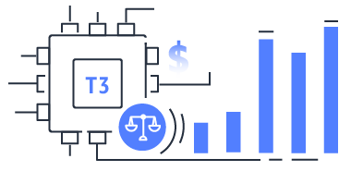
Scale for your workload
Burstable instance types
Dev/test
Smaller production databases
Baseline CPU performance
Burst performance with CPU credits

Slide 11


Scale for your workload
Scale up and down
Predictable workloads with periodic peaks
Fast failover with Multi-AZ
Optimize for response time
Choose CPUs / Hyper-Threading
CloudWatch
alarm
Lambda Function
8 vCPU
32 GiB
16 vCPU
64 GiB
16 vCPU
64 GiB
8 vCPU
32 GiB
ModifyDBInstance
ModifyDBInstance
db.m5.2xlarge
db.m5.4xlarge
db.m5.2xlarge
Notes:
Important
Some modifications result in an outage because Amazon RDS must reboot your DB instance for the change to take effect. Review the impact to your database and applications before modifying your DB instance settings.
https://docs.aws.amazon.com/AmazonRDS/latest/UserGuide/Overview.DBInstance.Modifying.html

Slide 12
Scale for your workload
Reserved Instances
Steady state workloads
1- and 3-year terms
No upfront, partial upfront, or all upfront
Savings up to 69%

Slide 13
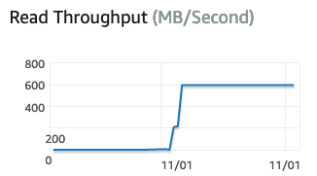
Challenges for Read-heavy Workloads
Infrastructure resource limits
Impact on other applications
Instance scaling
Logical replication management
Notes:
Scaling beyond the compute or I/O capacity of a single DB instance for read-heavy database workloads. You can direct this excess read traffic to one or more read replicas.
Serving read traffic while the source DB instance is unavailable. In some cases, your source DB instance might not be able to take I/O requests, for example due to I/O suspension for backups or scheduled maintenance. In these cases, you can direct read traffic to your read replicas. For this use case, keep in mind that the data on the read replica might be "stale" because the source DB instance is unavailable.
Business reporting or data warehousing scenarios where you might want business reporting queries to run against a read replica, rather than your production DB instance.
Implementing disaster recovery. You can promote a read replica to a standalone instance as a disaster recovery solution if the source DB instance fails.

Slide 14
Read Replicas Read scaling and disaster recovery
Application servers
Database server
RDS for PostgreSQL
Relieve pressure on your primary node with additional read capacity
Bring data close to your applications in different regions
Promote a read replica to a primary for faster recovery in the event of disaster
Read/write
Primary
Asynchronous replication
Read only
BI/reporting application server
Read replica
Notes:
RDS makes it easy to create read replicas of your database and automatically keeps them in sync with the master (for MySQL, PostgreSQL, and MariaDB engines). Read replicas are useful for both read scaling and disaster recovery use cases. You can add read replicas to handle read workloads so that your master database doesn’t become overloaded with read requests. Depending on the database engine, you can also place your read replica in a different region from your master which may give you the ability to have a read closer to a particular locality.
Finally, read replicas give you the ability to have another avenue for failover when there is a problem with the master, giving you coverage in the event of a disaster. You can combine Multi-AZ deployments and read replicas to enjoy the benefits of each. For example, you can configure a source database as Multi-AZ for high availability and create a read replica (in Single-AZ) for read scalability.
** IMPORTANT **
- You can promote a PostgreSQL read replica to be a new source DB instance. However, the read replica doesn't become the new source DB instance automatically. The read replica, when promoted, stops receiving WAL communications and is no longer a read-only instance. You must set up any replication you intend to have going forward because the promoted read replica is now a new source DB instance.
- Also , promoting a RR to primary would result in potential data loss (in flight) so it needs to thought through carefully.

Slide 15
Amazon RDS for Postgres read replicas
Up to 5 replicas per source instance; doesn’t require a outage on primary to start replica
Replicas can be Multi-AZ & across regions
Replicas can be promoted as new standalone databases
Monitor replication via Cloudwatch
https://docs.aws.amazon.com/AmazonRDS/latest/UserGuide/USER_PostgreSQL.Replication.ReadReplicas.html
https://docs.aws.amazon.com/AmazonRDS/latest/UserGuide/USER_ReadRepl.html
Notes:
Amazon RDS sets up a secure communications channel between the source DB instance and the read replica. Amazon RDS establishes any AWS security configurations needed to enable the secure channel, such as adding security group entries.
By default, a read replica is created with the same storage type as the source DB instance. However, you can create a read replica that has a different storage type from the source DB instance based on the options listed in the following table.
Amazon RDS doesn't support circular replication. You can't configure a DB instance to serve as a replication source for an existing DB instance.
When you create a read replica, Amazon RDS takes a DB snapshot of your source DB instance and begins replication. As a result, you experience a brief I/O suspension on your source DB instance while the DB snapshot occurs. The I/O suspension typically lasts about one minute. You can avoid the I/O suspension if the source DB instance is a Multi-AZ deployment, because in that case the snapshot is taken from the secondary DB instance

Slide 16

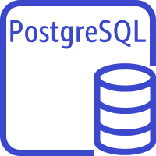
RDS PostgreSQL read replicas
Region 1
Region 2
Availability Zone A
Availability Zone B
Availability Zone A
Primary
db.r5.8xlarge
db.r5.8xlarge
HA – SYNC RDS service
RR – PostgreSQL native streaming replication
db.r5.8xlarge
Standby for HA (Multi-AZ secondary)
instance1 (Multi-AZ primary)
instance1 (Multi-AZ primary)
instance1-read-replica2 x region
RR – PostgreSQL
native streaming replication
RR – PostgreSQL native streaming replication
instance1-read-replica1
instance1-read-replica2
db.r5.4xlarge
db.r5.16xlarge

Slide 17

Logical replication – Initial Copy
Read/write workloads
Read workloads
2
Apply records as SQL
PostgreSQL Native logical replication
RDS PostgreSQL source instance
RDS PostgreSQL target instance
1
Capture Data Capture changes
Notes:
https://docs.aws.amazon.com/AmazonRDS/latest/AuroraUserGuide/AuroraPostgreSQL.Replication.Logical.html
https://aws.amazon.com/blogs/database/using-logical-replication-to-replicate-managed-amazon-rds-for-postgresql-and-amazon-aurora-to-self-managed-postgresql/

Slide 18

Replication with DMS (Database Migration Service)
Read/write workloads
Read workloads
3
Apply records as SQL
RDS PostgreSQL source instance
AWS Database Migration Service
RDS PostgreSQL target instance
1
Capture Data Capture changes
2
Write changes to replication instance

Slide 19

Performance Planning
All databases including PostgreSQL workloads typically benefit from large amounts of memory (caching)
Consider db.R5 - Memory Optimized instances for production
DB instances can be modified to change the DB instance class
Requires a reboot (or failover in Multi-AZ)
Can scale compute capacity with the workload, if practical
Use DB Parameter Groups to adjust DB instance configuration
Default parameter groups follow AWS & PostgreSQL recommendations
Amazon RDS storage throughput depends on DB instance class

Slide 20
LAB

